Slide 1


Status Report TTbar resonances Angular Distributions NTUA
George Bakas

Slide 2
Progress Report
DCS
fwInstallationUtils:
Deploy the component
Changes in the database (create new tables etc)
Test that the tool works both when being operated with user credentials and when being operated without user credentials
Trying to Figure multiple scenarios that may go wrong
CMSfwInstallUtils
Conf DB checks tool
Why it takes so long to apply checks between project and db
Make the tool as generic as possible
Analysis:
TTbar Angular distributions for several mass values of Z’
Hands on 2017 MC’s.
Much more samples for the Zprime masses
Production of QCD and Mtt samples
Re-train and check outputs between 2016 and 2017
Waiting for the cross sections for the Mtt samples. The XsecDB does not include all the cross sections for the samples that I need
Deep AK8: Lisa sent an email, waiting for Working Points

Slide 3
Search for top-antitop resonances
Numerous extensions of the SM predict the existence of new interactions with enhanced couplings to third generation quarks, especially the top quark
The associated new particle → observation as a ttbar resonance
Examples of such resonances:
Massive Color-singlet Z like bosons (Z’)
Colorons
Axigluons
Heavier Higgs siblings
Kaluza-Klein excitations of gluons
Electroweak gauge bosons
Gravitons in various extensions of the Randall-Sundrum model
All of the above predict the existence of TeV-scale resonances with a cross section of a few pb’s
Resonant ttbar production would be observable in the reconstructed invariant mass of the ttbar system
Most analyses search for peaks in the invariant ttbar mass

Slide 4
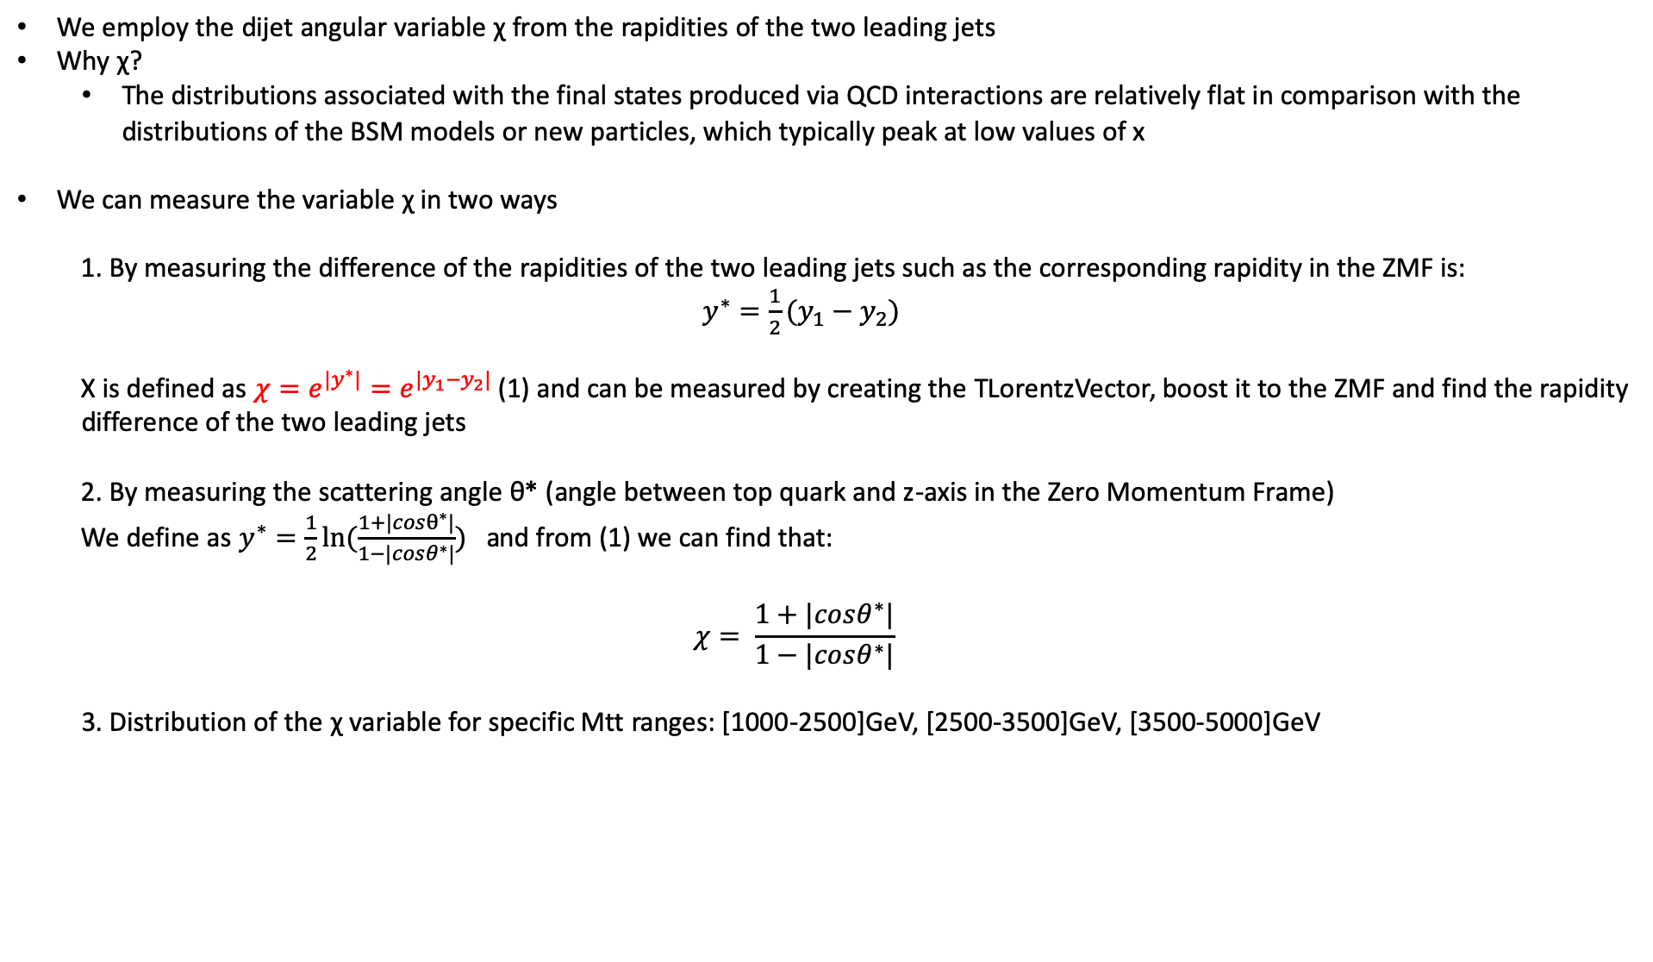
Variables
We employ the dijet angular variable χ from the rapidities of the two leading jets
Why χ?
The distributions associated with the final states produced via QCD interactions are relatively flat in comparison with the distributions of the BSM models or new particles, which typically peak at low values of x
We can measure the variable χ in two ways
1. By measuring the difference of the rapidities of the two leading jets such as the corresponding rapidity in the ZMF is: $y^{∗}=\frac{1}{2}(y_{1}−y_{2})$
Χ is defined as $χ=e^{{|y}^{∗}|}=e^{|y_{1}−y_{2}|}$ (1) and can be measured by creating the TLorentzVector, boost it to the ZMF and find the rapidity difference of the two leading jets
2. By measuring the scattering angle θ* (angle between top quark and z-axis in the Zero Momentum Frame)
We define as $y^{∗}=\frac{1}{2}ln⁡(\frac{1+|cosθ^{∗}|}{1−|cosθ^{∗}|})$ and from (1) we can find that:
$$χ= \frac{1+|cosθ^{∗}|}{1−|cosθ^{∗}|}$$
3. Distribution of the χ variable for specific Mtt ranges: [1000-2500]GeV, [2500-3500]GeV, [3500-5000]GeV

Slide 5
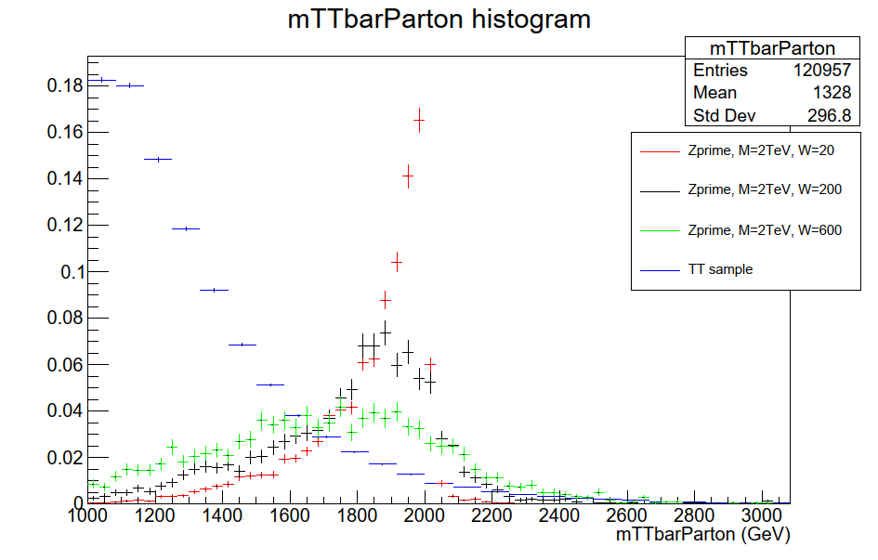
M_{tt} distribution for Mtt sample (1000-Inf) and Zprime samples with M_{Z’} = 2TeV and different widths

Slide 6
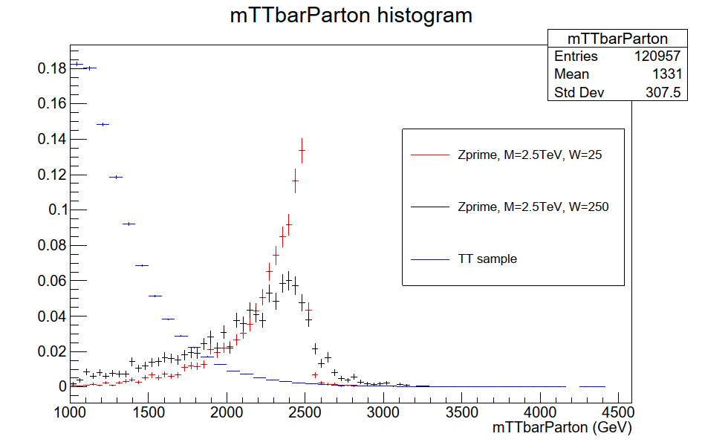
M_{tt} distribution for Mtt sample (1000-Inf) and Zprime samples with M_{Z’} = 2.5TeV and different widths

Slide 7
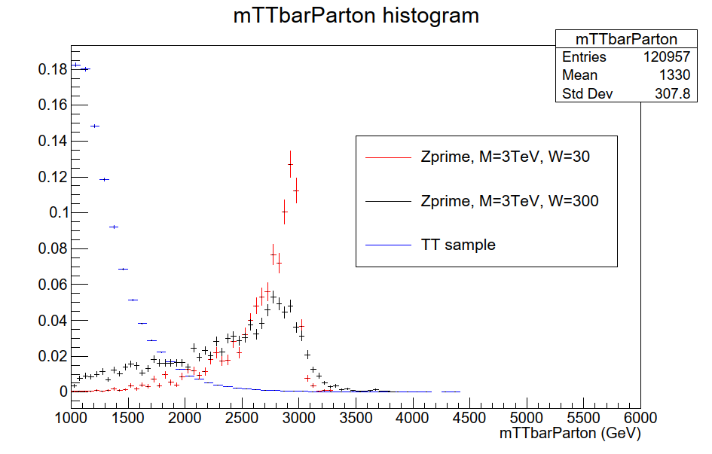
M_{tt} distribution for Mtt sample (1000-Inf) and Zprime samples with M_{Z’} = 3TeV and different widths

Slide 8
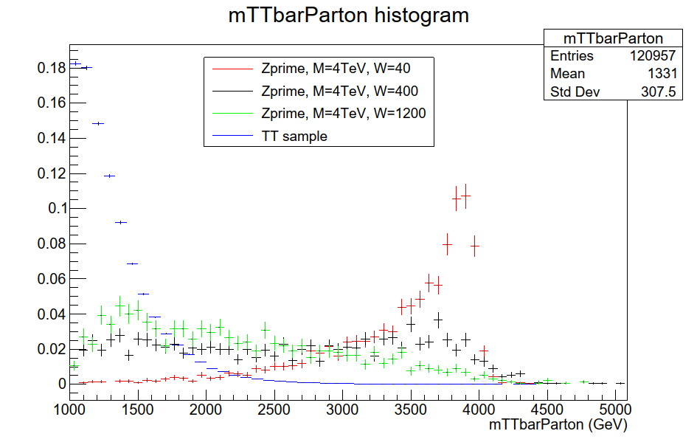
M_{tt} distribution for Mtt sample (1000-Inf) and Zprime samples with M_{Z’} = 4TeV and different widths

Slide 9
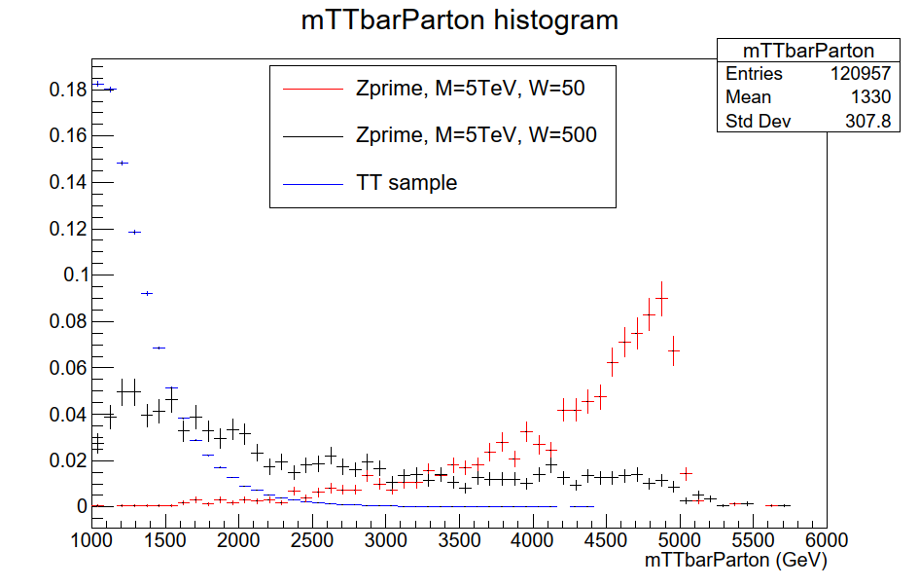
M_{tt} distribution for Mtt sample (1000-Inf) and Zprime samples with M_{Z’} = 5TeV and different widths

Slide 10
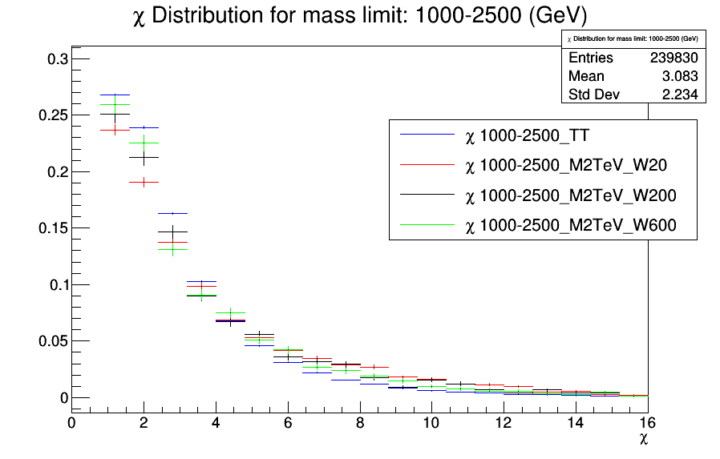
χ distribution for Mtt sample (1000-Inf) and Zprime samples with M_{Z’} = 2TeV and different widths

Slide 11
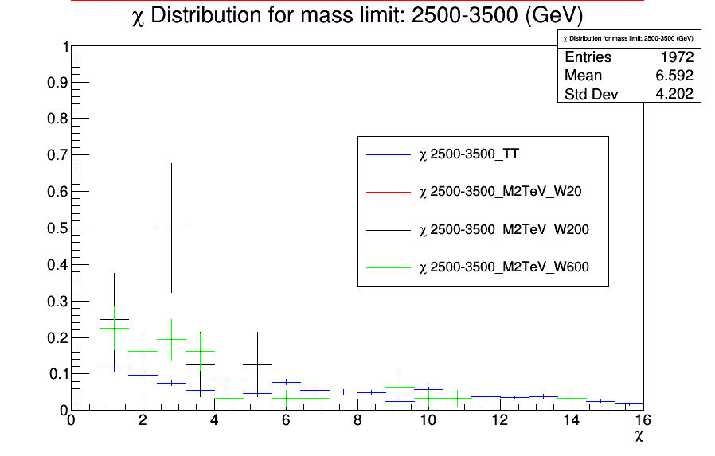
χ distribution for Mtt sample (1000-Inf) and Zprime samples with M_{Z’} = 2TeV and different widths

Slide 12
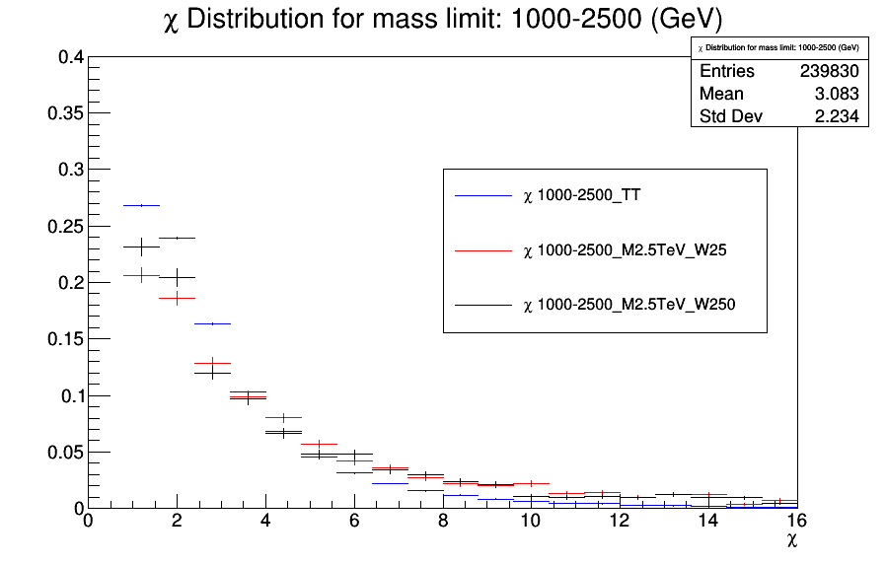
χ distribution for Mtt sample (1000-Inf) and Zprime samples with M_{Z’} = 2.5TeV and different widths

Slide 13
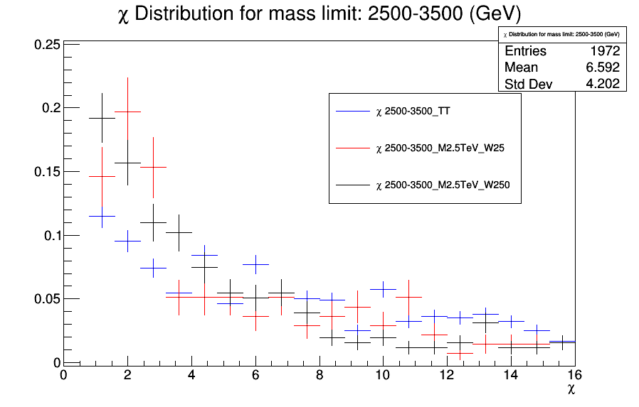
χ distribution for Mtt sample (1000-Inf) and Zprime samples with M_{Z’} = 2.5TeV and different widths

Slide 14
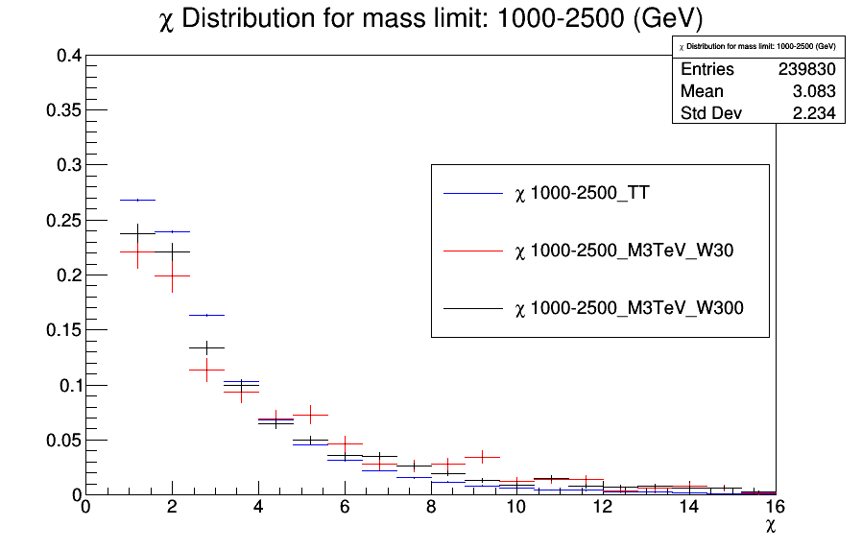
χ distribution for Mtt sample (1000-Inf) and Zprime samples with M_{Z’} = 3TeV and different widths

Slide 15
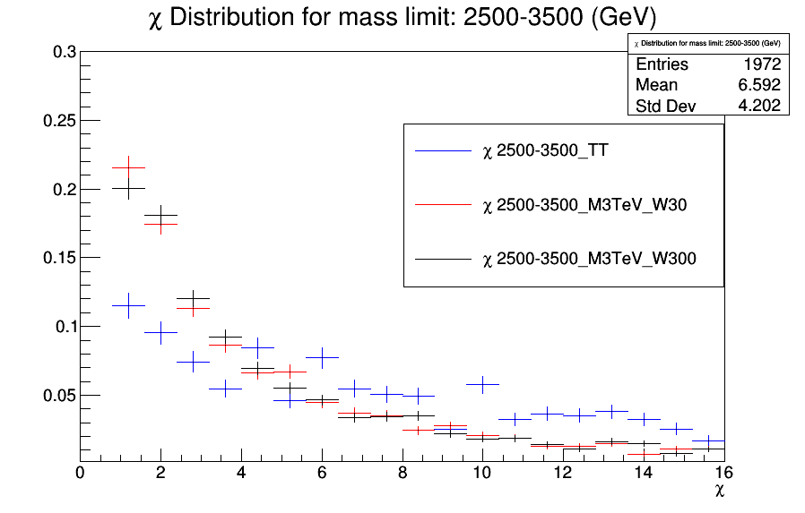
χ distribution for Mtt sample (1000-Inf) and Zprime samples with M_{Z’} = 3TeV and different widths

Slide 16
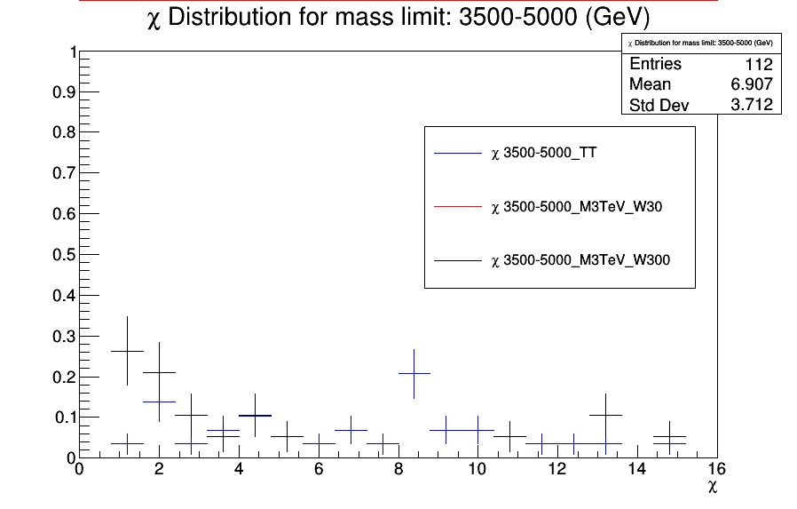
χ distribution for Mtt sample (1000-Inf) and Zprime samples with M_{Z’} = 3TeV and different widths

Slide 17
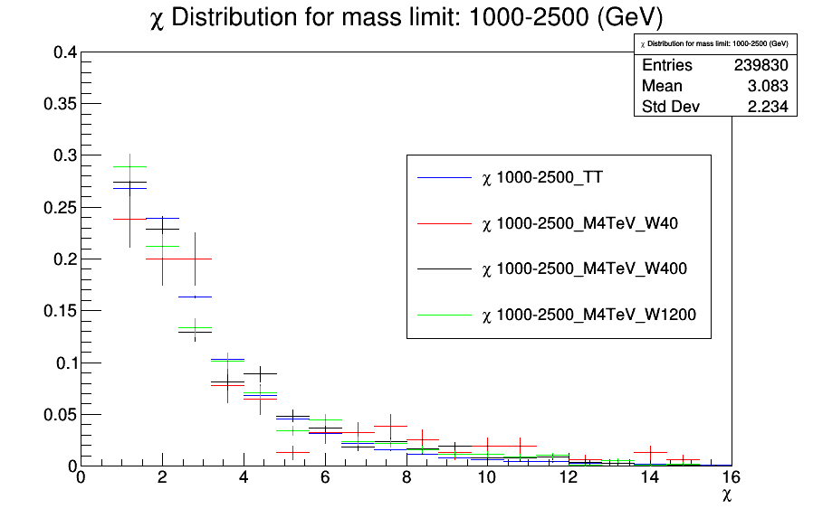
χ distribution for Mtt sample (1000-Inf) and Zprime samples with M_{Z’} = 4TeV and different widths

Slide 18
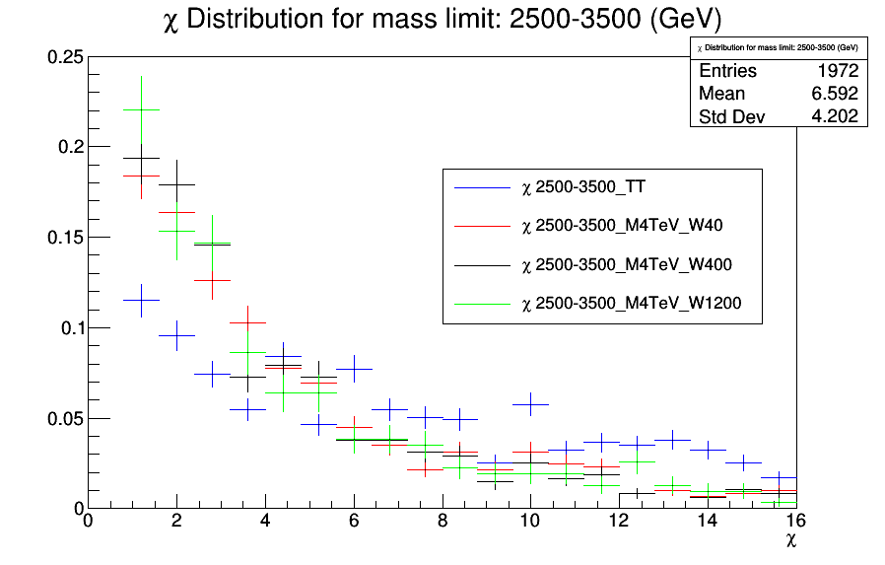
χ distribution for Mtt sample (1000-Inf) and Zprime samples with M_{Z’} = 4TeV and different widths

Slide 19
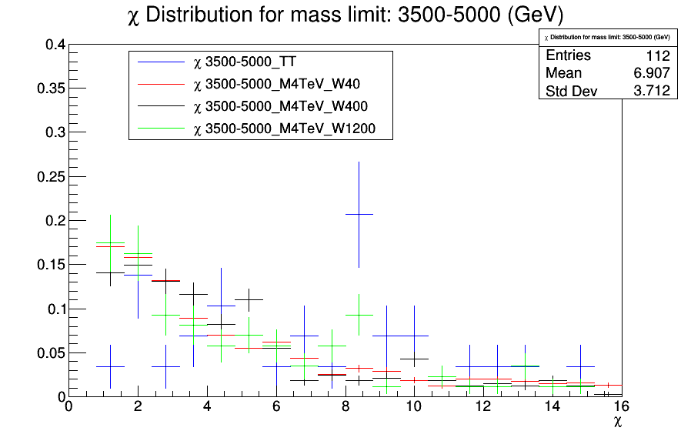
χ distribution for Mtt sample (1000-Inf) and Zprime samples with M_{Z’} = 4TeV and different widths

Slide 20
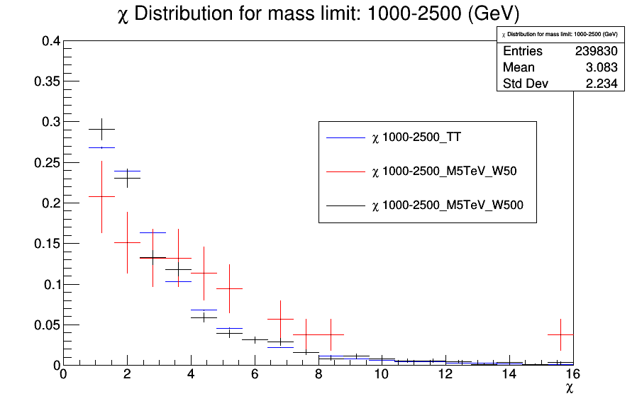
χ distribution for Mtt sample (1000-Inf) and Zprime samples with M_{Z’} = 5TeV and different widths

Slide 21
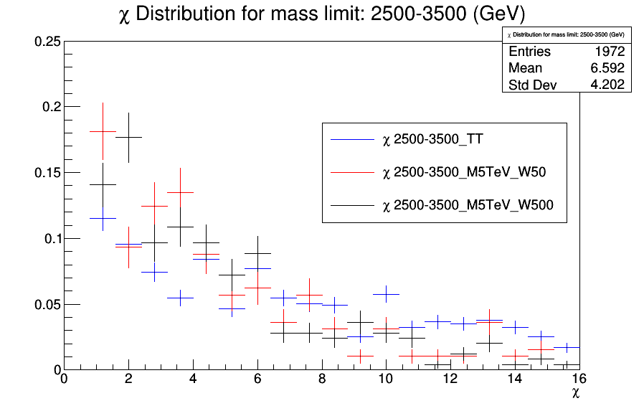
χ distribution for Mtt sample (1000-Inf) and Zprime samples with M_{Z’} = 5TeV and different widths

Slide 22
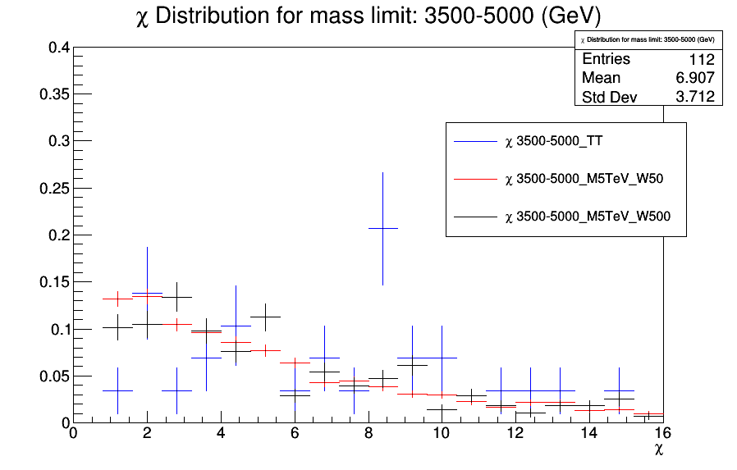
χ distribution for Mtt sample (1000-Inf) and Zprime samples with M_{Z’} = 5TeV and different widths

Slide 23
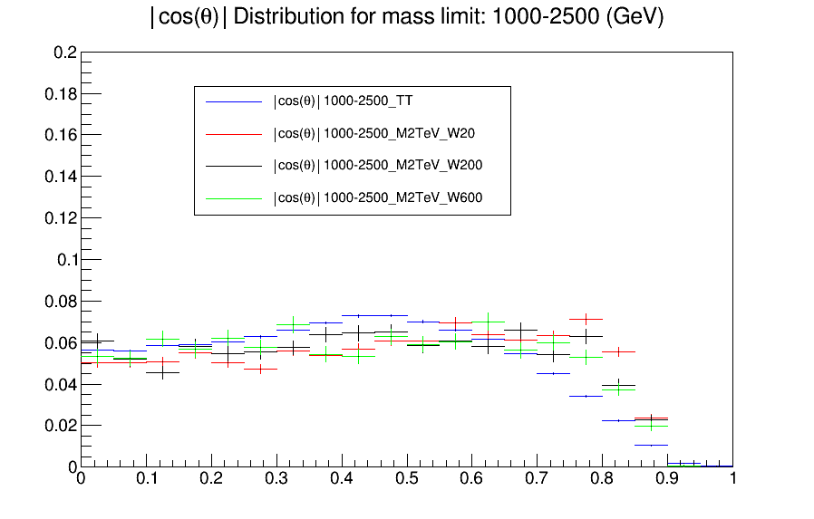

|cosθ*| distribution for Mtt sample (1000-Inf) and Zprime samples with M_{Z’} = 2TeV and different widths
$$|cosθ^{∗}|$$

Slide 24
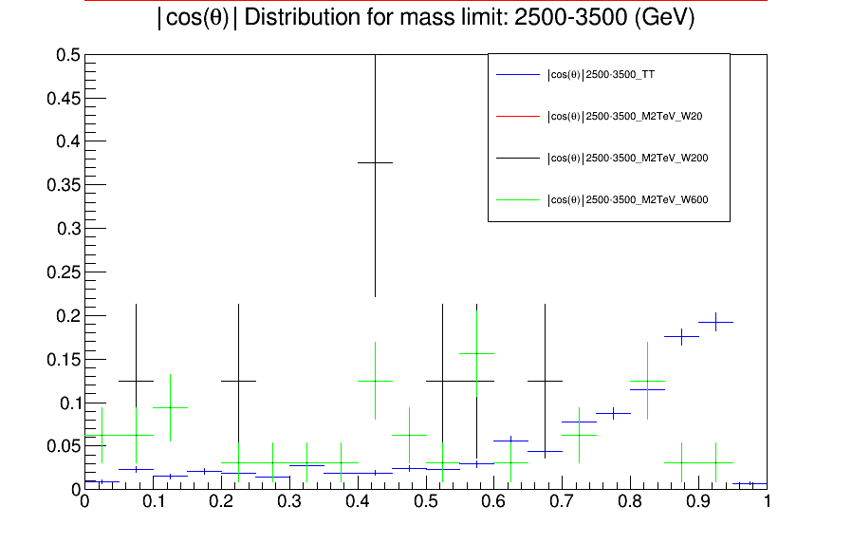
|cosθ*| distribution for Mtt sample (1000-Inf) and Zprime samples with M_{Z’} = 2TeV and different widths
$$|cosθ^{∗}|$$

Slide 25
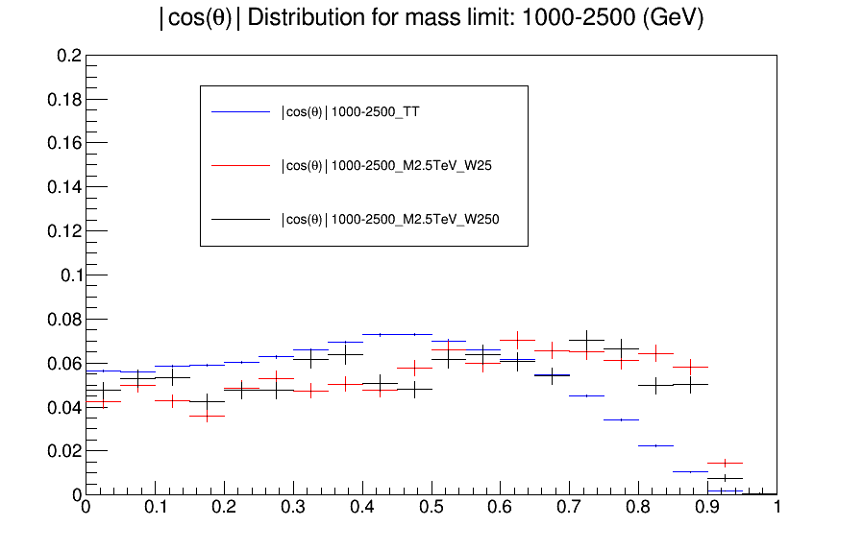
|cosθ*| distribution for Mtt sample (1000-Inf) and Zprime samples with M_{Z’} = 2.5TeV and different widths
$$|cosθ^{∗}|$$

Slide 26
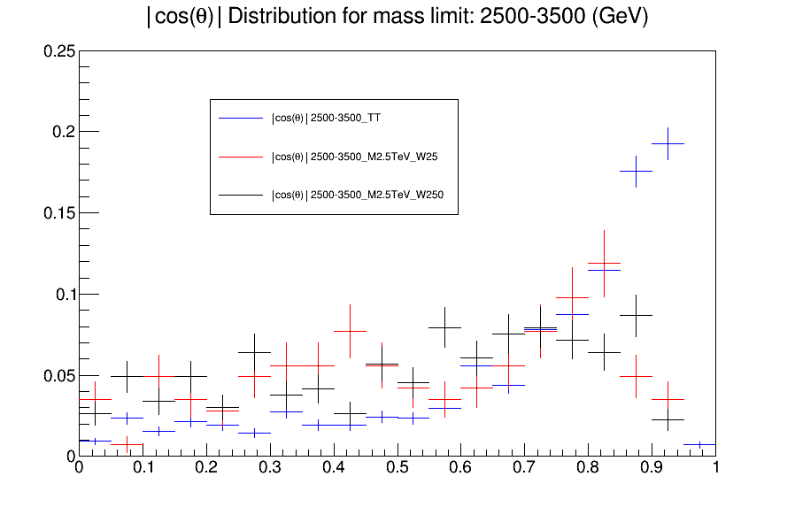
|cosθ*| distribution for Mtt sample (1000-Inf) and Zprime samples with M_{Z’} = 2.5TeV and different widths
$$|cosθ^{∗}|$$

Slide 27
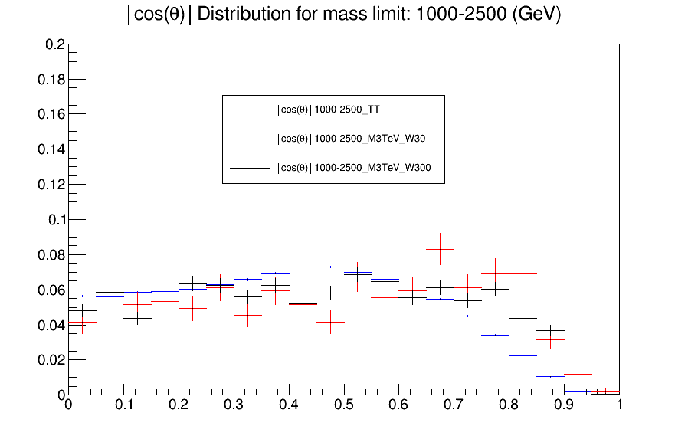
|cosθ*| distribution for Mtt sample (1000-Inf) and Zprime samples with M_{Z’} = 3TeV and different widths
$$|cosθ^{∗}|$$

Slide 28
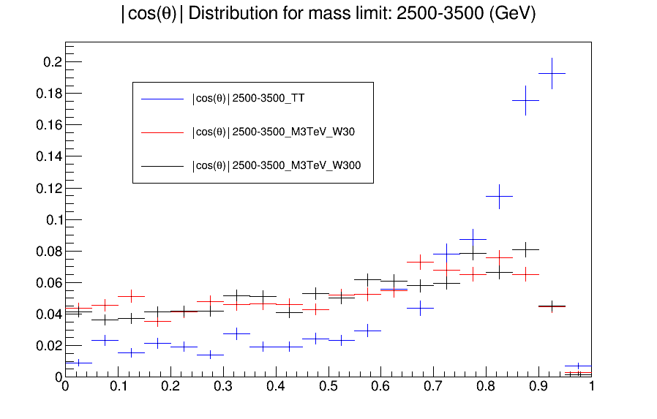
|cosθ*| distribution for Mtt sample (1000-Inf) and Zprime samples with M_{Z’} = 3TeV and different widths
$$|cosθ^{∗}|$$

Slide 29
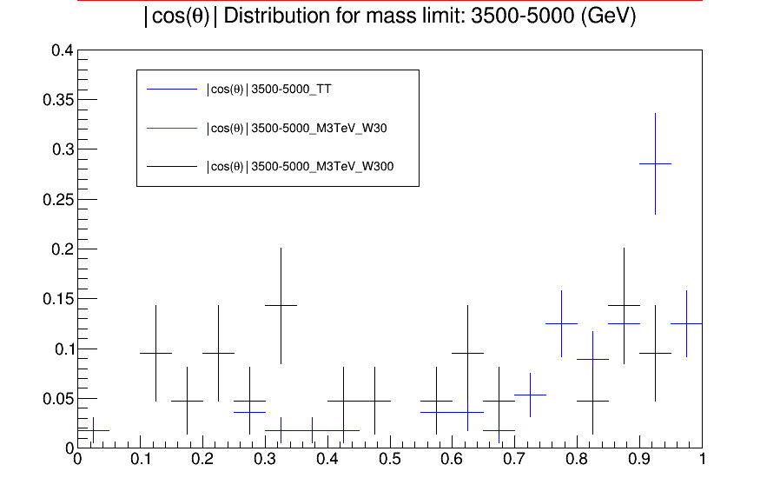
|cosθ*| distribution for Mtt sample (1000-Inf) and Zprime samples with M_{Z’} = 3TeV and different widths
$$|cosθ^{∗}|$$

Slide 30
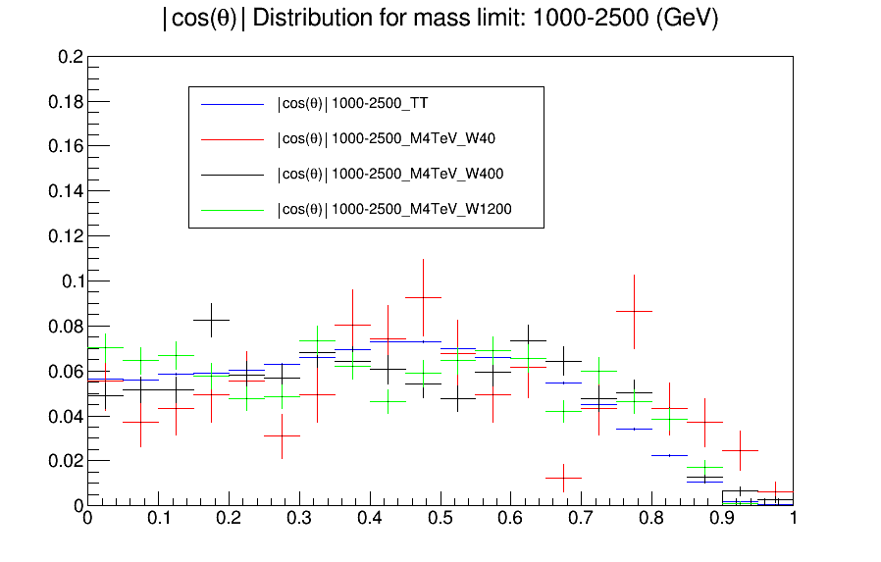
|cosθ*| distribution for Mtt sample (1000-Inf) and Zprime samples with M_{Z’} = 4TeV and different widths
$$|cosθ^{∗}|$$

Slide 31
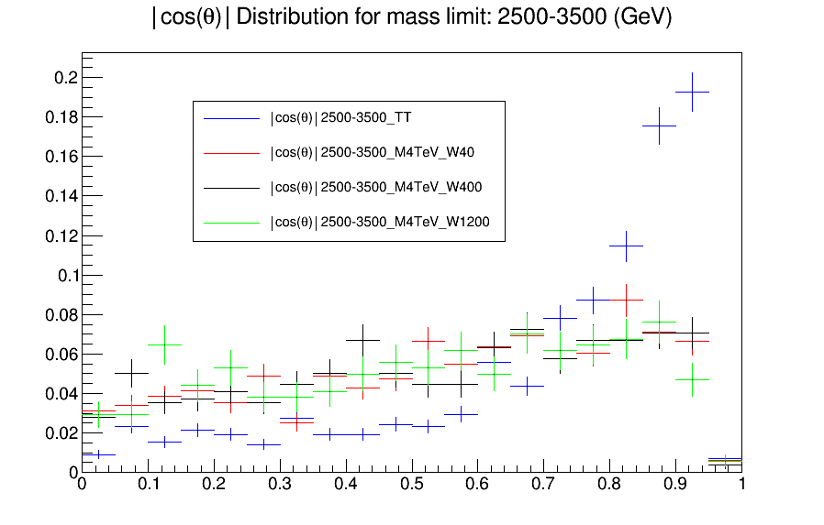
|cosθ*| distribution for Mtt sample (1000-Inf) and Zprime samples with M_{Z’} = 4TeV and different widths
$$|cosθ^{∗}|$$

Slide 32
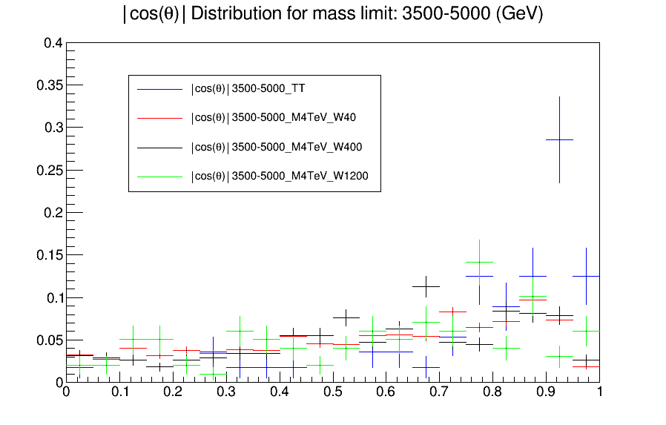
|cosθ*| distribution for Mtt sample (1000-Inf) and Zprime samples with M_{Z’} = 4TeV and different widths
$$|cosθ^{∗}|$$

Slide 33
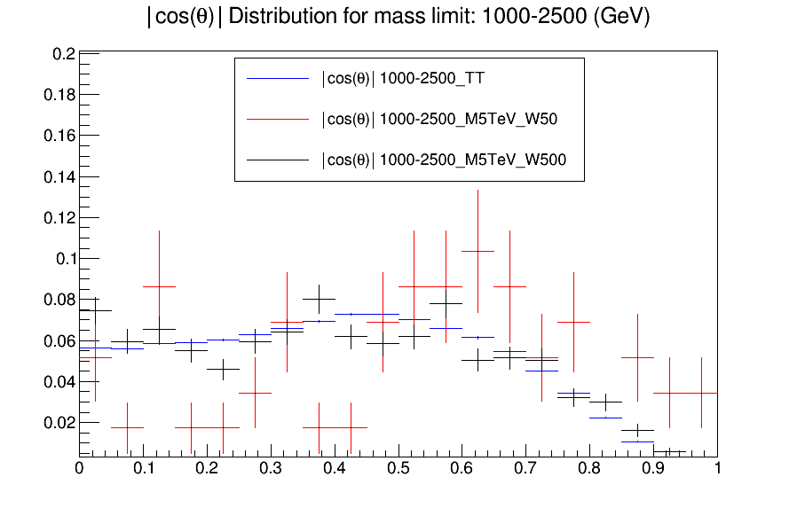
|cosθ*| distribution for Mtt sample (1000-Inf) and Zprime samples with M_{Z’} = 5TeV and different widths
$$|cosθ^{∗}|$$

Slide 34
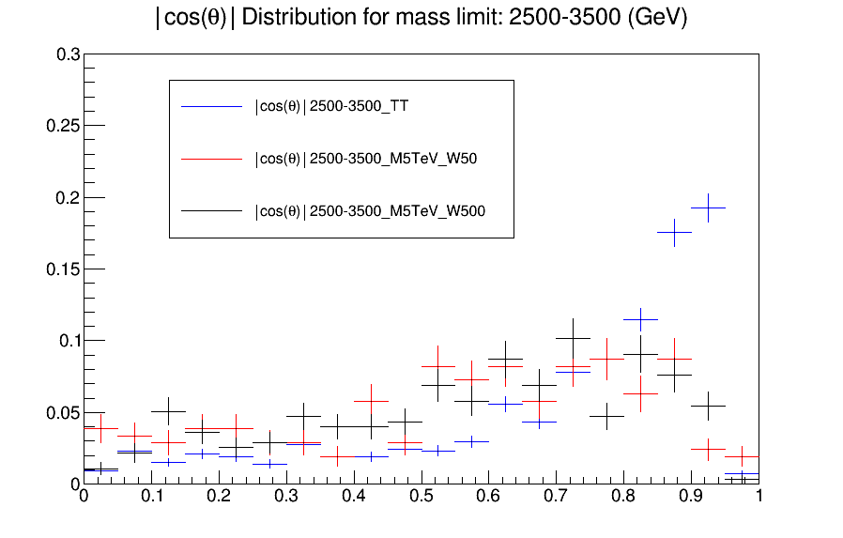
|cosθ*| distribution for Mtt sample (1000-Inf) and Zprime samples with M_{Z’} = 5TeV and different widths
$$|cosθ^{∗}|$$

Slide 35
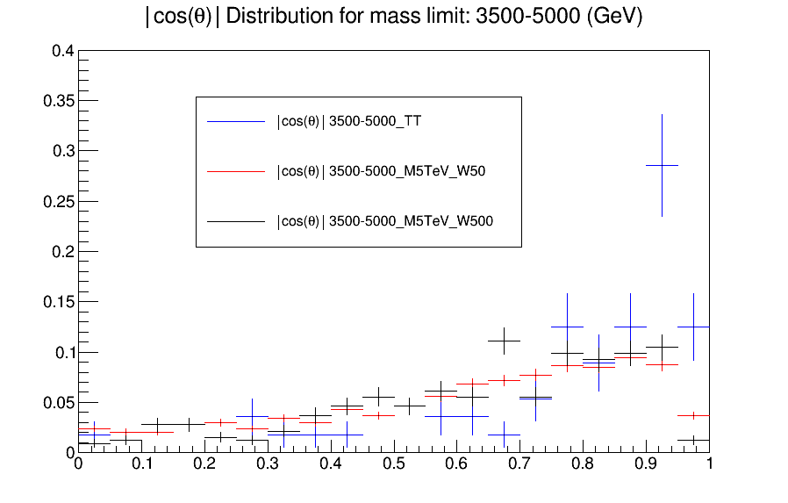
|cosθ*| distribution for Mtt sample (1000-Inf) and Zprime samples with M_{Z’} = 5TeV and different widths
$$|cosθ^{∗}|$$

